Slide 1
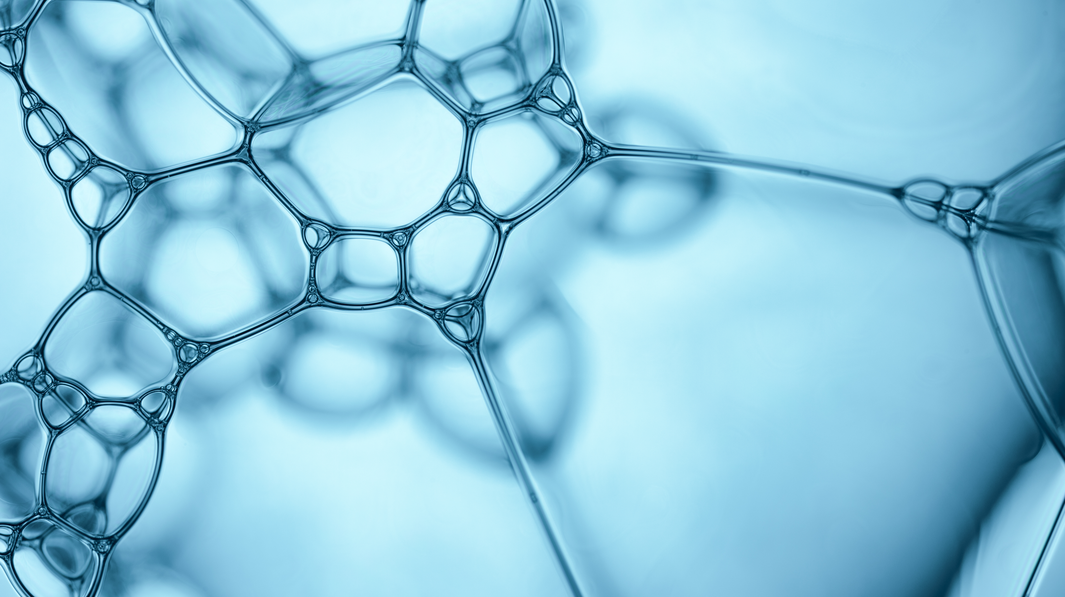
Clients’ churn prediction
Valentyn Burenkov

Slide 2

Aim of the model
Business goal
To retain clients before 2 months of their actual churn (no incoming events, no outgoing events, no paid events)
Task
To detect clients that will churn in 2 month
Task type
Binary classification

Slide 3
Business understanding
1) Enhanced understanding of the client’s future behavior
2) Marketing companies, intended to retain the client
3) Income prediction

Slide 4
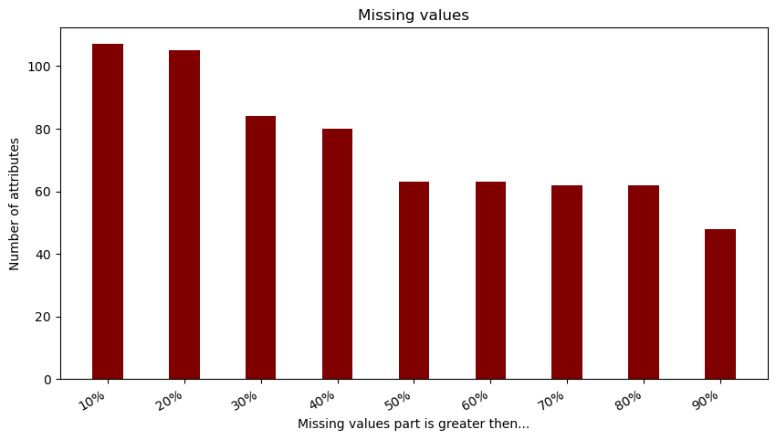
Input data understanding. Main dataset
Main Dataset
General information about clients (300_000 rows, 816 characteristics)

Slide 5
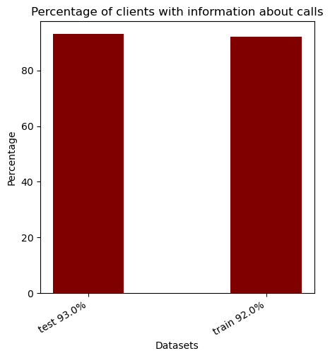
Input data understanding. Telephone dataset
Telephone dataset
Information about clients calls (1_340_788 rows, 8 characteristics, average number of calls per number 4.83)

Slide 6
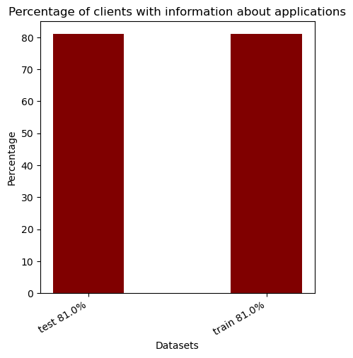
Input data understanding. Application dataset
Application dataset
Information about clients calls (13_485_098 rows, 6 characteristics, average number of application records per client 55.23)

Slide 7
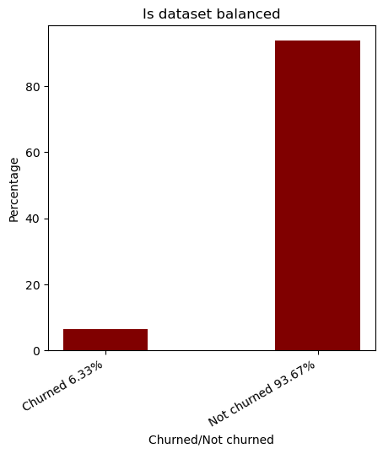
Is dataset balanced

Slide 8
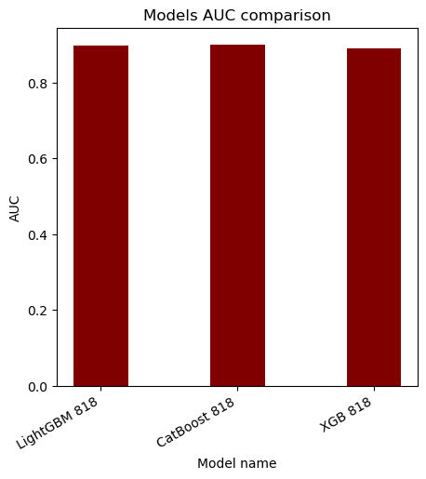
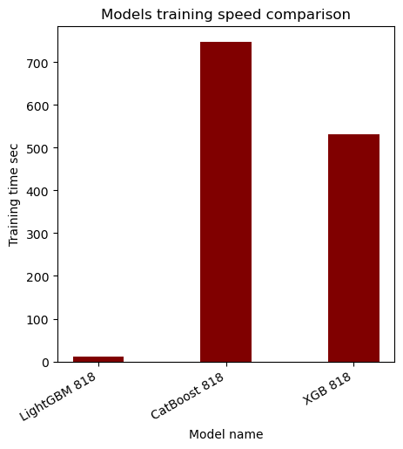
Boosting algorithms comparison
Gradient boosting - algorithm that combines several weak learners into strong learners, as a rule - trees. Here comparison of most popular boosting algorithms with default parameters over main dataset.

Slide 9
Algorithm selection
LightGBM
Gives one of the best AUC by default
Faster training speed
Lower memory usage
Support of parallel, distributed, and GPU learning
Capable of handling large-scale data

Slide 10
Iterative feature selection flow chart

Slide 11
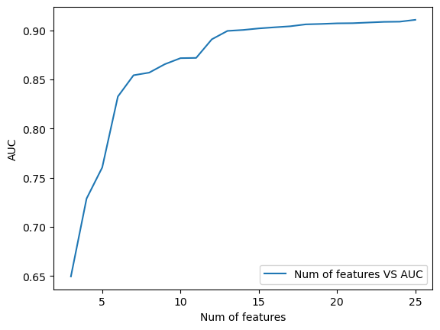
Number of features vs AUC

Slide 12
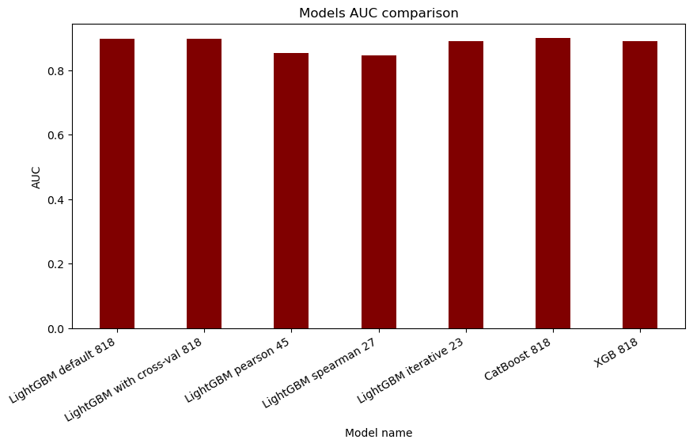
Feature selection techniques comparison
Compare models using AUC parameter

Slide 13
Telephone feature engineering
Check inbound calls from non-vodafone number in minutes
Check outbound calls to non-vodafone number in minutes
SMS from non-vodafone number count
SMS to non-vodafone number count
SMS to pawnshops, micro credit organizations
SMS from pawnshops, micro credit organizations
Dataset size: 300_000 x 824
Total features taken to final mode: 0

Slide 14
Application feature engineering
Add the following information for every user for every application he is using. Every piece of data is added as a separate column.
Duration of sessions in the application
Volume of send/received data
Number of sessions in the applications
Number of days of application usage
Dataset size: 300_000 x 3930
Total applications: 776
Total features taken to final mode: 9

Slide 15
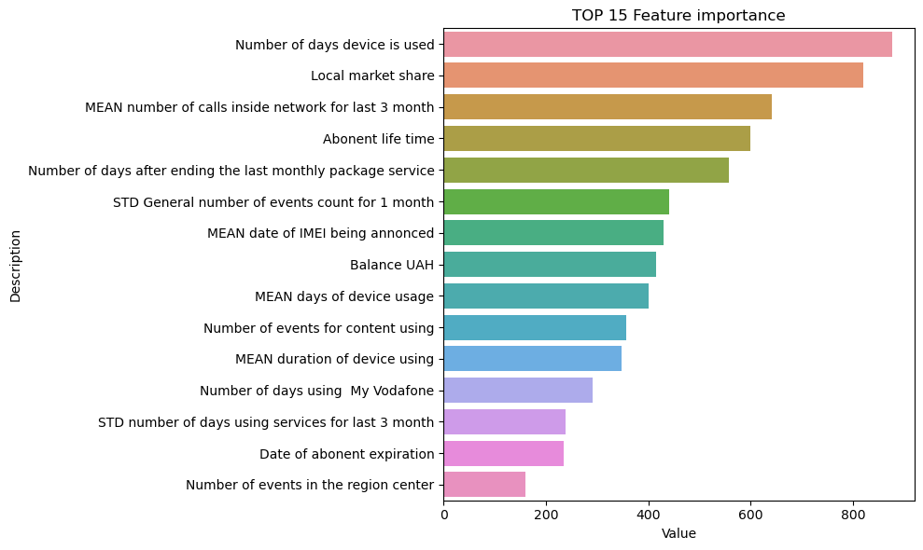
Final feature set has 32 features Top 15

Slide 16
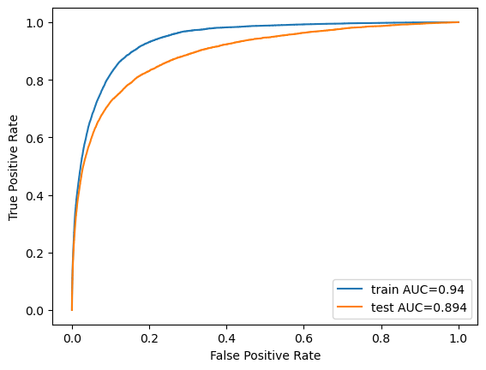
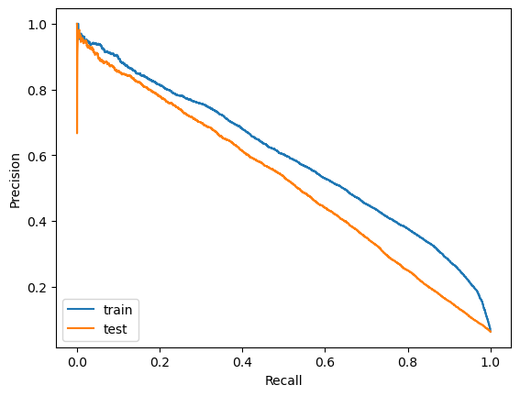
Metrics Train AUC = 0.94 Test AUC = 0.894 simplify
ROC curve answers the question of how well the model performs with no knowledge of the class imbalance, whilst the PR curve uses our estimated class imbalance baseline to inform us of how well our model performs, given the specific imbalance we provided it.
Precision-Recall (PR) curve is specifically tailored for the detection of rare events and is the metric that should be used when the positive class is of more interest than the negative one

Slide 17
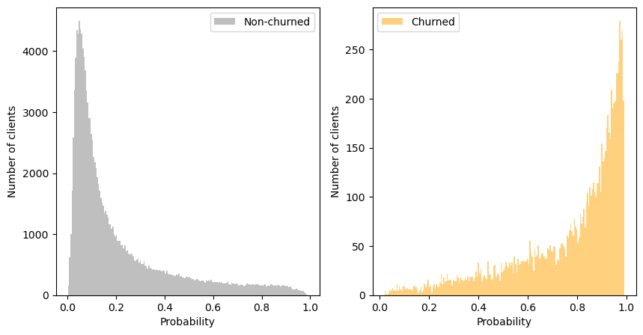
Probability distribution
Probability distribution gives the probabilities of occurrence of different possible outcomes (churned or not-churned)

Slide 18
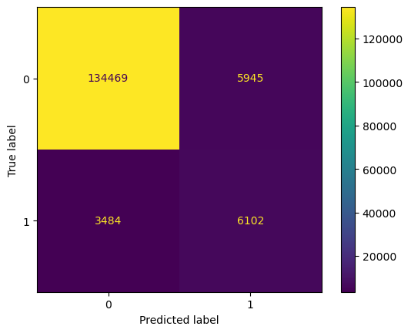
F1 based threshold selection 0.23
Confusion matrix a table that is used to define the performance of a classification algorithm.
The F1 score is a measure of a model’s performance. It is a weighted average of the precision and recall of a model, with results tending to 1 being the best, and those tending to 0 being the worst.
F1 = (2*TP) / (2*TP+FP+FN)

Slide 19
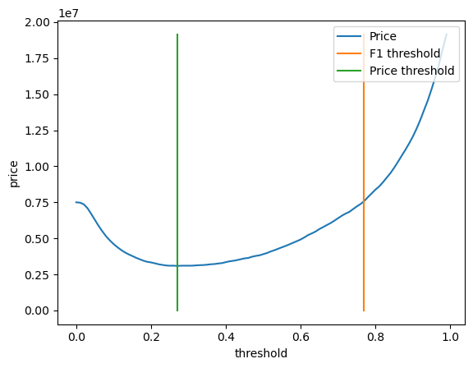
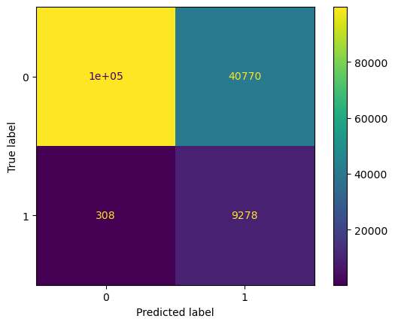
Expenses based threshold 0.78
Expenses = TP* RETAIN + FP*RETAIN + FN*ADD_NEW
Let’s assume that retain price is 50 UAH, add new client price (including missed income) is 4000 UAH.
F1 price: 14_573_400 UAH
Price based: 3_734_400 UAH
Do nothing: 38_344_000 UAH

Slide 20
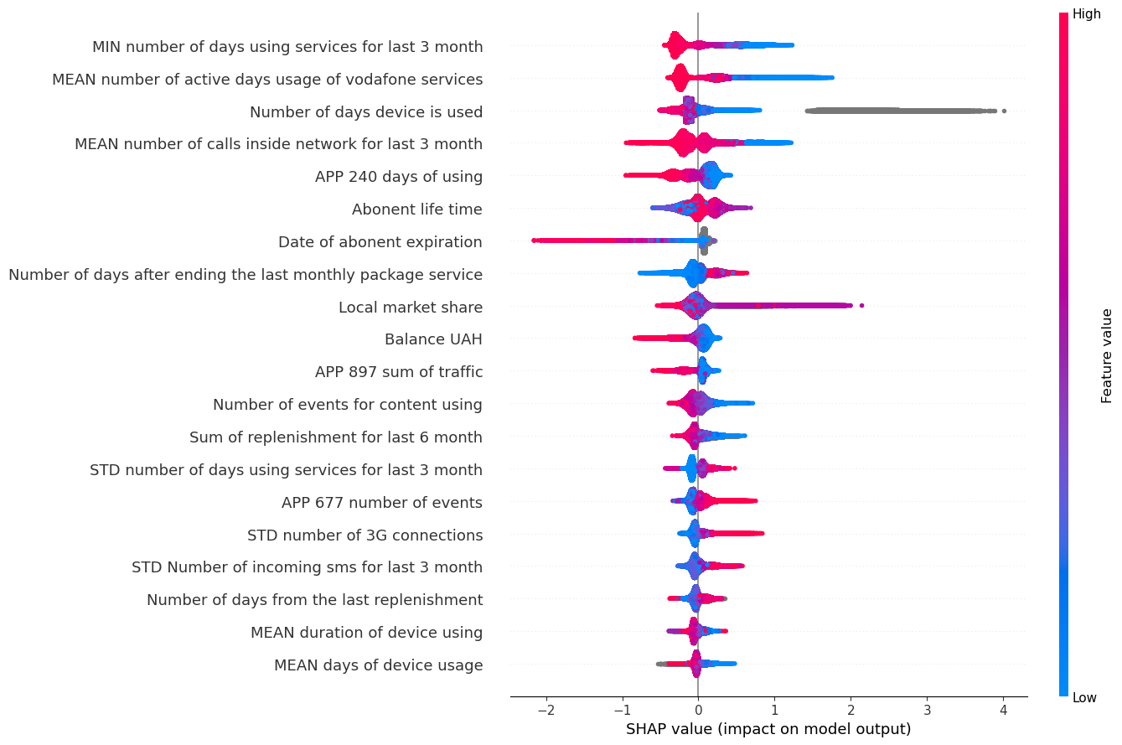
SHAP

Slide 21
SHAP insights
1) App 240 less using – churn 2) App 897 less traffic – churn 3) App 677 more events – churn 4) More 3G connections – churn. This can be explained by better conditions provided by other operators. 5) Number of incoming sms increase – churn. This can be explained by scenario when previous owner was a debtor and decided to change number. Now new number’s owner receives debtor sms.

Slide 22
Future enhancements
Use models ensemble (for example CatBoost better predicts not-churned clients)
Use models of different types
Generate another features from telephones dataset
Analysis where model makes wrong predictions
Thanks for attention!

